Slide 1
Conjugate Gradient Method
Inna Williams
Saturday, June 1, 2019

Slide 2
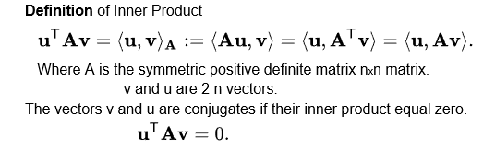
Inner Product
The Conjugate Gradient Method converges to the solution of a positive-definite
n × n linear system by successively locating and eliminating the n orthogonal components of the error, one by one. The complexity of the algorithm is minimized by using the directions established by pairwise orthogonal residual vectors. The idea behind this method is to use inner product.

Slide 3

Inner Product (contd.)
A is symmetric matrix and therefore inner product retain the properties of symmetry, linearity and positive definiteness of A, therefore
If matrix A is positive definite and v != 0 then (v, v) = Transpose(v) Av > 0
If u is conjugate to v, then v is conjugate to u. If we have a set of n mutually conjugate vectors with respect to A then we can express the solution x of
Ax = b in this basis.
If choose the conjugate vectors in proper way that allows to approximately solve systems where n is so large that the direct method would take too much time.

Slide 4

Algorithm
The conjugate gradient iteration finds the solution of Ax=b starting with initial vector r_{n}=r₀ by updating three different vectors on each step. The vector x_{n} is the approximate solution at step n, the vector r_{n} the residual of the approximate solution x_{n} and vector p_{n} that represents the new direction of the next step of the search. Each residual is made to be orthogonal to all the previous residuals. If this can be done then eventually the method will run out of the orthogonal directions where to continue next step of the search.
The method stops when residual reaches zero and solution found in n steps.
Vector p_{n} is pairwise conjugate and represent the direction of the algorithm. This vector chosen from vector space of previous residuals. Every next residual must be orthogonal to the previous residuals. If this can be done then eventually the method will run out of the orthogonal directions where to continue next step of the search.

Slide 5
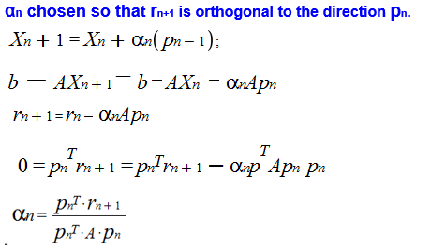
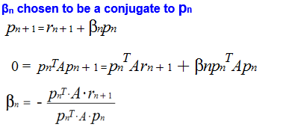
Choice of α and β
The method stops when residual reaches zero and solution found in n steps.
Vector pn is pairwise conjugate and represent the direction of the algorithm. This vector chosen from vector space of previous residuals. Every next residual must be orthogonal to the previous.

Slide 6
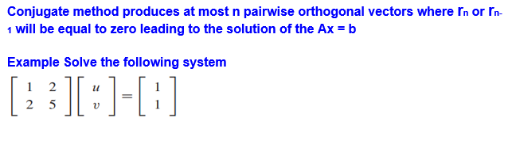
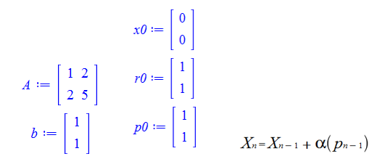
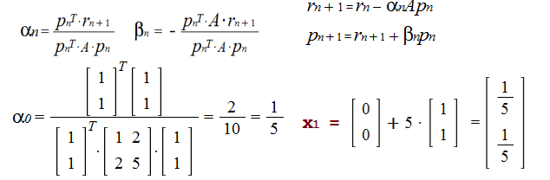
Solution By Hand

Slide 7
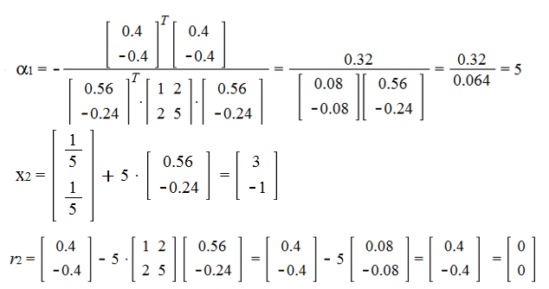
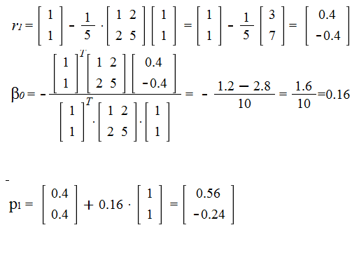
Solution By Hand (contd.)

Slide 8
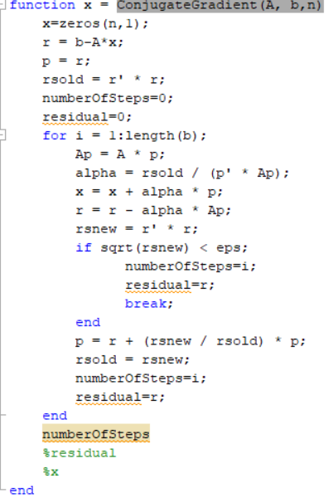
Code
Code that solves this problem written in MATLAB

Slide 9
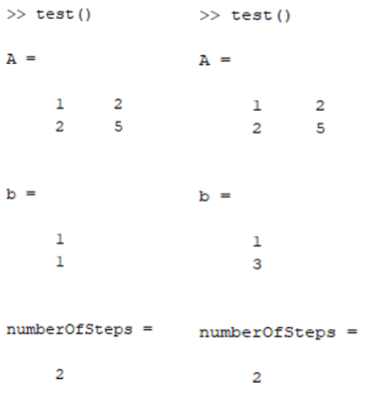
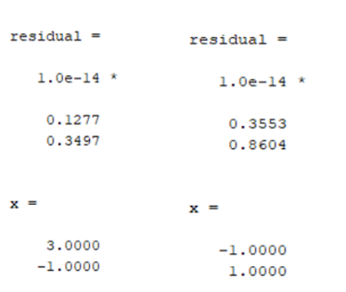
Output
Using the following test in MATLAB
Output:

Slide 10
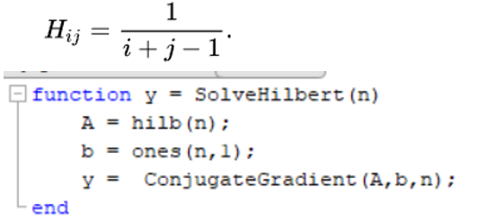
Hilbert Matrix Example
Solve the system
Hx = b , where H is the n × n Hilbert matrix and b is the vector of all ones
This code will create Hilbert Matrix and call the Conjugate Gradient method to solve it
For n = 3, 4

Slide 11
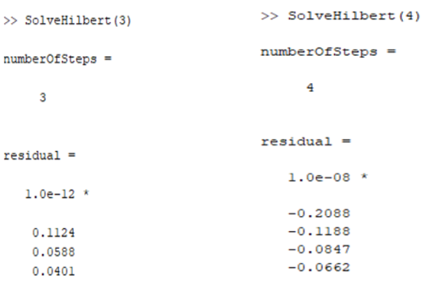
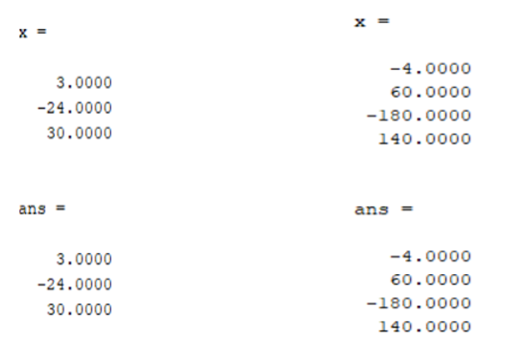
Output

Slide 12
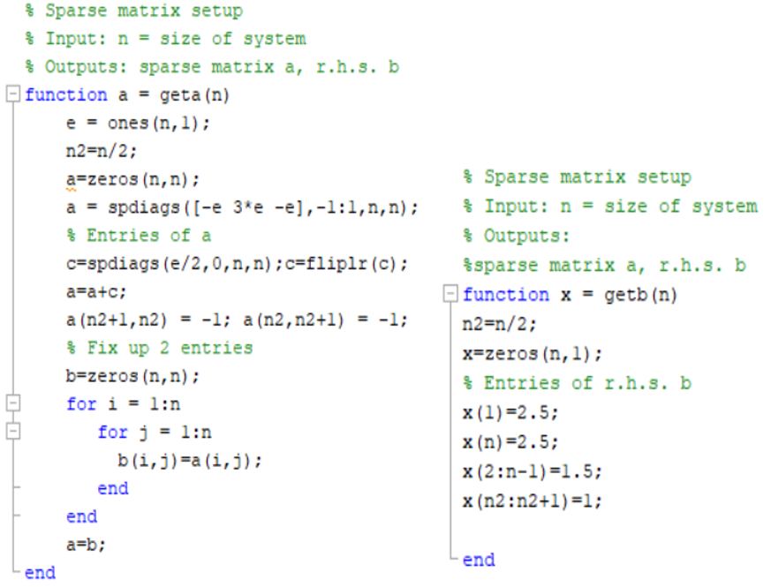
Example Sparse Matrix
Find the solution to where A is a sparse matrix and vector b defined below
The solution is the solution is x = [1,1,1,1,1,1]
Find for n = 6, 100, 1000, 10000

Slide 13
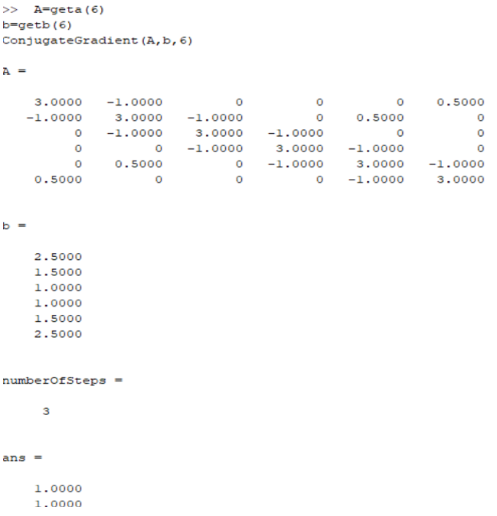
n = 6

Slide 14
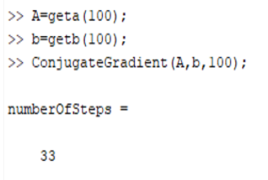
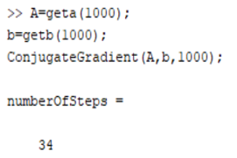
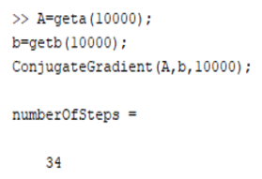
n = 100 , 1000, 10000

Slide 15
Conclusion
Conjugate gradient method applicable to sparse systems that are too large to be handled by a direct implementation or other direct methods such as the Cholesky decomposition. Large sparse systems often arise when numerically solving partial differential equations or optimization problems.

Slide 16
Questions

